Slide 1
Introduction to ChatGPT

Slide 2
ChatGPT - Introduction
Chat Generative Pre-Trained Transformer (ChatGPT) is an AI chatbot released by OpenAI in 2022.
The core function of ChatGPT is to mimic a human conversationalist.
AI chatbots have existed for many years, but the domain of their conversations are very limited, and their application is usually limited to specific tasks (e.g. online customer service).
However, due to the cutting-edge model architecture, reinforcement learning with human feedback, and an enormous and meticulously curated textual data set, ChatGPT is the most versatile and robust AI chatbot to date.
Many other companies (Google, Microsoft, Amazon, etc.) are developing competitor chatbots using the same ML techniques.

Slide 3
ChatGPT - Introduction
ChatGPT is a large language model, a type of AI trained on vast amounts of curated text from the internet.
The underlying architecture of GPT is the Transformer, a family of neural networks which have been the premier natural language processing model since its inception in 2017.
We will look at the Transformer tomorrow in more depth!
ChatGPT learns syntactic and semantic language patterns by analyzing billions of words and sentences in various contexts.
It is an autoregressive model, meaning that it generates the next most likely word in its output by looking at its previously generated words.
The model’s responses are generated based on probability of word occurrence, and the computer doesn’t “actually understand” what it’s saying.
This means that there is no guarantee that what ChatGPT outputs is accurate or sensical.
Notes:
This includes Wikipedia articles, books, and WebText2 and Common crawl, huge repositories of text on the Internet with policies controlling document quality.
Syntactic: grammar, how to arrange words to create well-formed sentences. Semantic: using language to express meaningful information
Autoregressive: it starts generating words, then uses the previously generated words as an input to help generate the next word.

Slide 4
ChatGPT - Capabilities
Due to its emergent versatility, ChatGPT is capable of performing many complex tasks, including but not limited to:
Writing and debugging computer programs
Composing essays and stories
Translating or summarizing text
Answering examination questions
Simulate scenarios
Perhaps most interestingly, receive feedback and remembers conversations, allowing extended and dynamic conversations.
Much development has been done to increase the accuracy of ChatGPT’s responses, reduce bias in answering subjective/controversial topics, and overall reduce harmful or deceitful responses.
While large improvements have been made, ChatGPT still receives criticism for its shortcomings.

Slide 5
ChatGPT - Limitations
ChatGPT is fundamentally a probabilistic word prediction engine, and its goal is more or less to provide a plausible sounding answer. Often, it will provide a plausible sounding but incorrect or nonsensical answer.
A limitation in all AI systems are the quality of the training data. Despite the large training data set, it is not “knowledgeable” about many events, especially recent ones.
ChatGPT tends not to be able to provide in depth information, sticking to summaries and short answers.
Since no curated data set can be unbiased, each iteration of ChatGPT has been criticized for its perceived political bias when discussing politicians, world events, and public figures.
As more training and human feedback are always being given to the model, these issues are changing with each update.
Notes:
3: This is a personal observation
4: You could imagine that if data was not curated and filtered, there would be a lot of unhelpful garbage data. But since the data set is filtered to prevent this, bias is introduced.

Slide 6
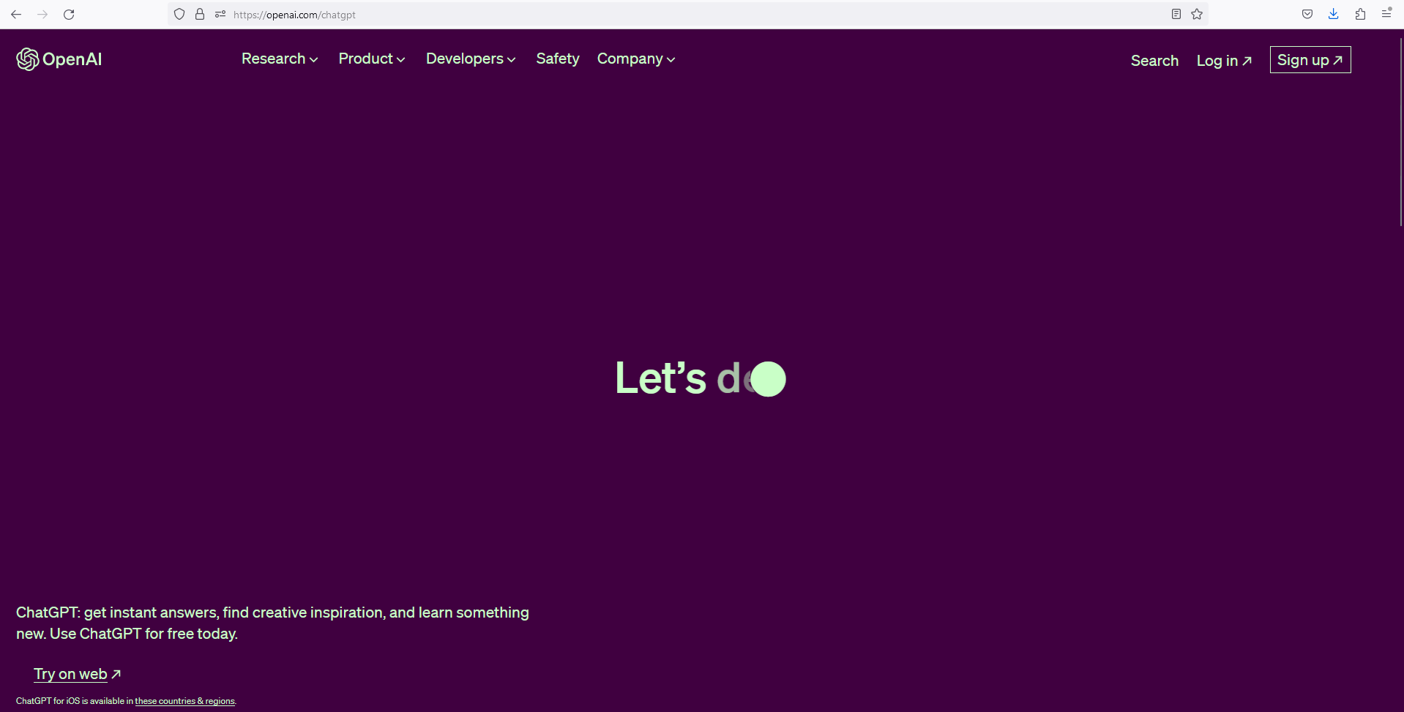
ChatGPT – How to Use
Go to https://openai.com/chatgpt and sign up for an account.
After confirming, you can access the service from the same page by logging in.

Slide 7
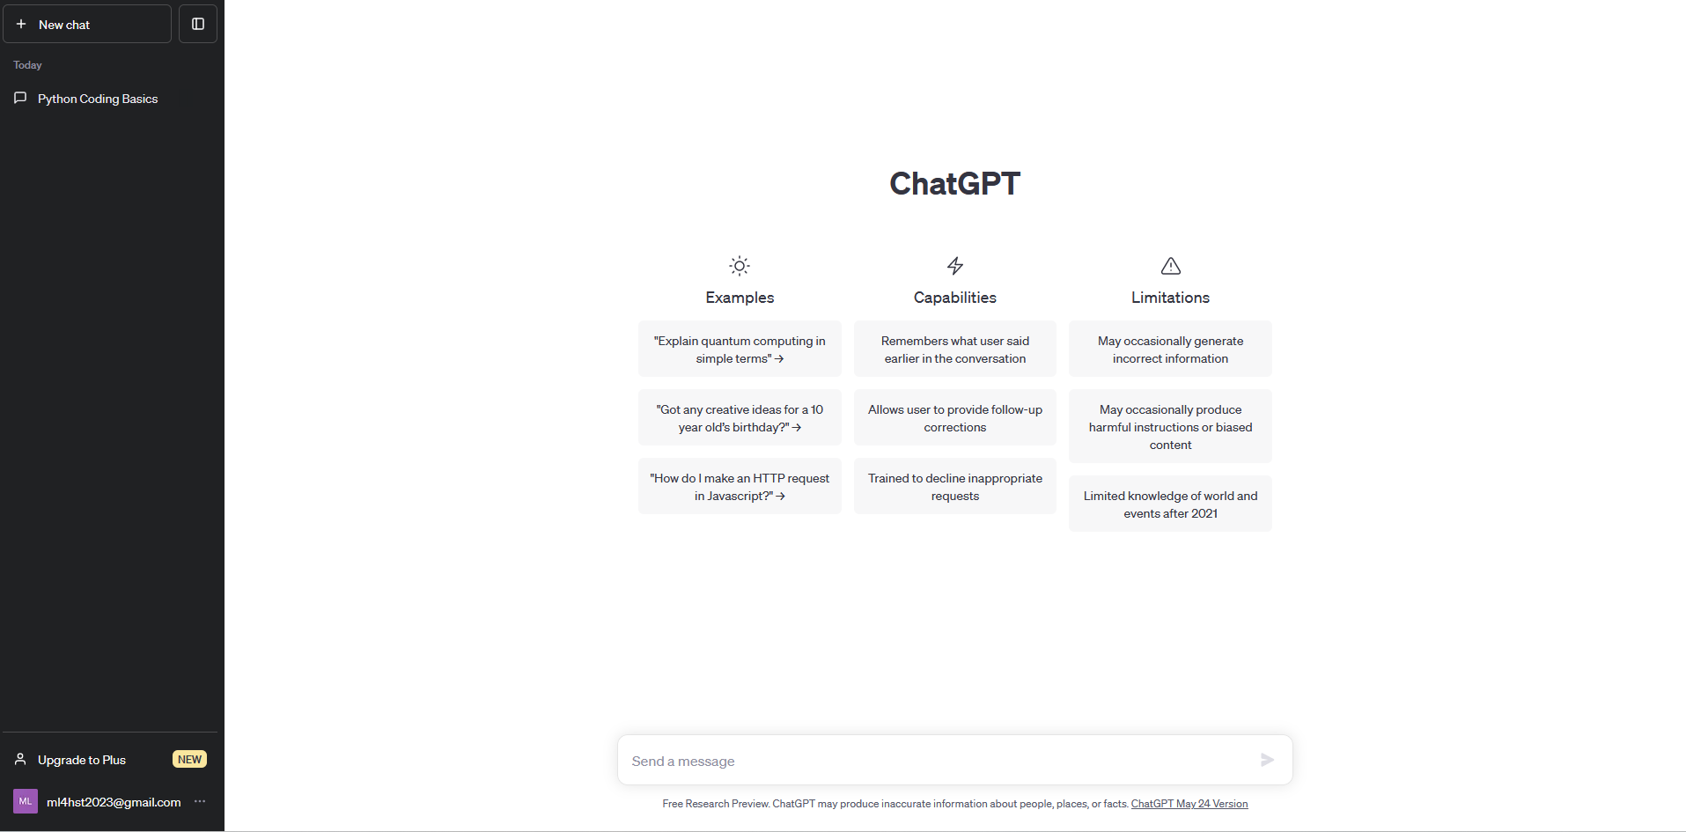
ChatGPT – How to Use
Start new chat
Access old chats to resume conversations in previous context
Write questions or responses in the chat

Slide 8
ChatGPT – Education
Students are likely going to leverage ChatGPT to assist them with assignments in the following ways:
Quickly generating text for writing assignments based on prompt
Text summarization
Essay writing
Getting step-by-step solutions to math problems
Use instead of or along with a search engine as a information gathering tool
ChatGPT and similar AI tools are a paradigm shifting technology, and their impact on many sectors, including education, will be equally unpredictable and profound.
One thing we can be sure of; AI tools like ChatGPT are only going to become more widespread.
Your student’s are going to try to use it, so its important for you to know the capabilities and limitations so they can use it as a tool and not a crutch.

Slide 9

ChatGPT – Writing
ChatGPT can be used for generating writing based on a simple prompt
For most well-documented subject matter, ChatGPT can be quite coherent and factually correct.

Slide 10
ChatGPT – Writing
However, ChatGPT can make things up which have no basis in reality!
In this article:
The editor of a consumer firearm magazine asked ChatGPT to summarize a court case, Second Amendment Foundation v. Ferguson. ChatGPT provided a summary which stated that the plaintiff accused Georgia radio host Mark Walters of defrauding and embezzling funds from the SAF. This was for background research for a case which the editor was reporting on.
Mark Walters, in the ongoing lawsuit Walters v. OpenAI LLC, claims that every fact in the summary is false, stating that he was never a party involved in the lawsuit and that he was never accused of fraud against the SAF.
See also this study uncovering GPT’s ability to generate more persuasive disinformation than humans.
In general, ChatGPT is more likely to be factually inaccurate when the subject matter is more obscure or recent.

Slide 11
ChatGPT – Writing
There are a few (imperfect) tools, also based on AI models, which purport to detect whether text was written by a language model, including OpenAI’s own AI text classifier and the third party ZeroGPT.
The next slide shows ZeroGPT’s assessment on three writing samples.
Note that these detection tools are lagging behind the language models.
My own written summary was still flagged as likely to contain AI generated content, so these measures are not perfect yet.

Slide 12
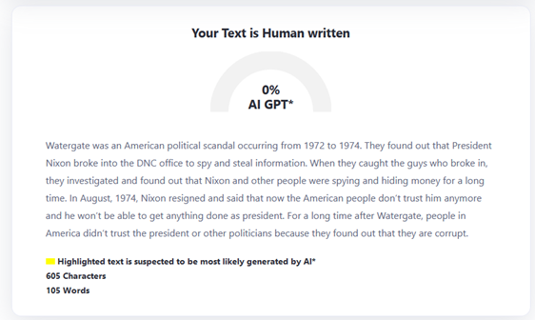
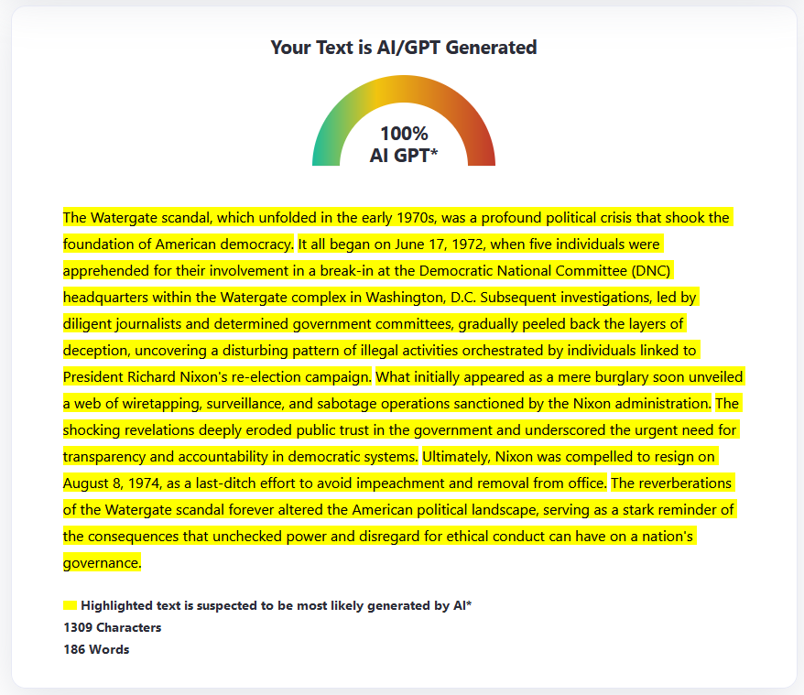
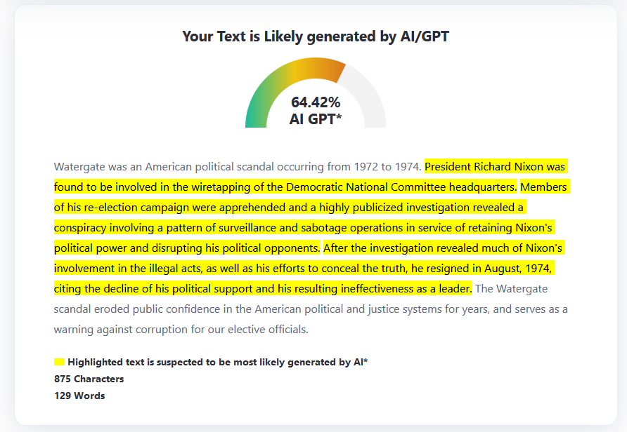
ChatGPT – Writing
Summary written by me. I tried to replicate a the casual tone of an uninterested high school student.
Summary generated by ChatGPT
Summary written by me. I tried to replicate the professional and neutral tone of ChatGPT.

Slide 13
ChatGPT – Writing
Tips:
Explore ChatGPT by messing around with it. Ask it questions on a variety of topics, factual and subjective, and get a sense of its tone, capabilities, and limitations.
You could think of ChatGPT as a system which gives a response which is the “statistical consensus” of its training data set. Thus, ChatGPT tends to speak in a formal tone, often restates part of the prompt given to it, and is rather ambivalent on most opinionated topics. You can learn to spot this sort of writing, especially if submitted by a high school student.
While you likely don’t want students writing entire assignments with AI tools, these tools are very valuable for gathering information. Learn the tools and approaches to detecting AI generated text and you can better regulate your student’s responsible usage of ChatGPT for writing.

Slide 14
ChatGPT – Math
As its primary use is as a natural language processor, it only “understands” quantitative reasoning in so far as it understands logic from semantics.
ChatGPT has mixed results when it comes to solving math problems.
While it can sometimes answer a question with impressive insight, it can also fail with equal confidence.

Slide 15
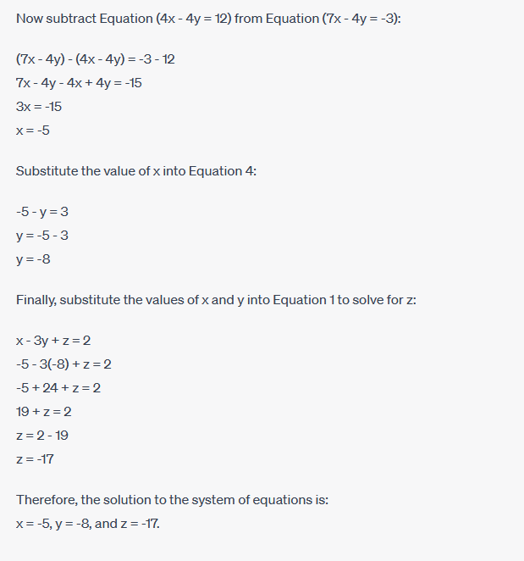
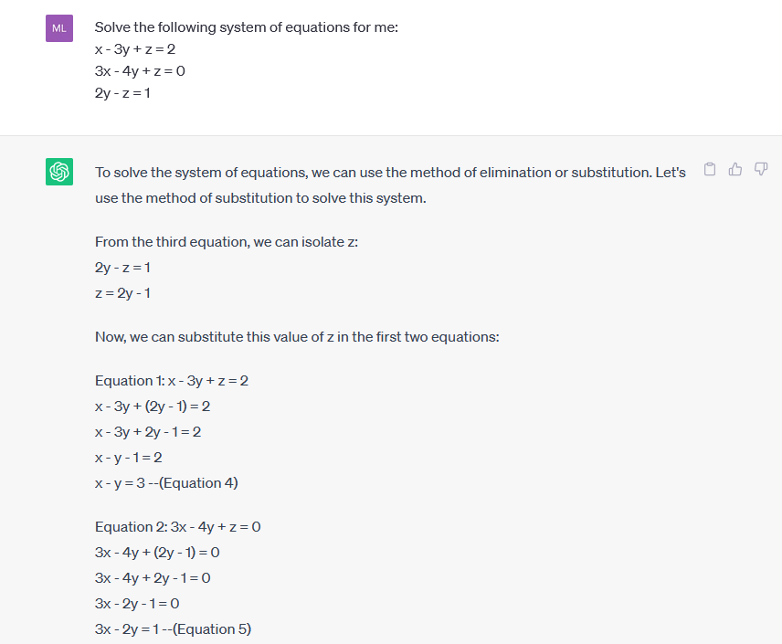
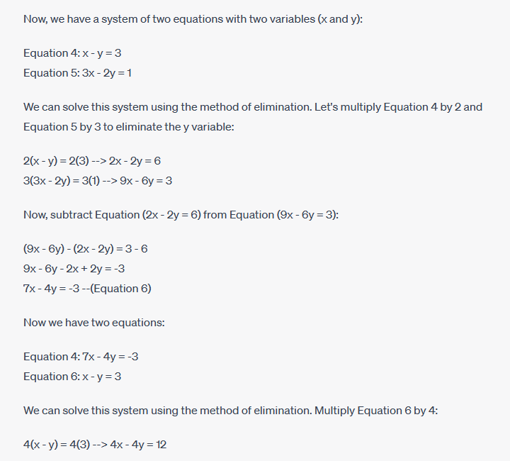
ChatGPT – Math
Here I ask ChatGPT to solve a system of algebraic equations:
These answers are correct!

Slide 16
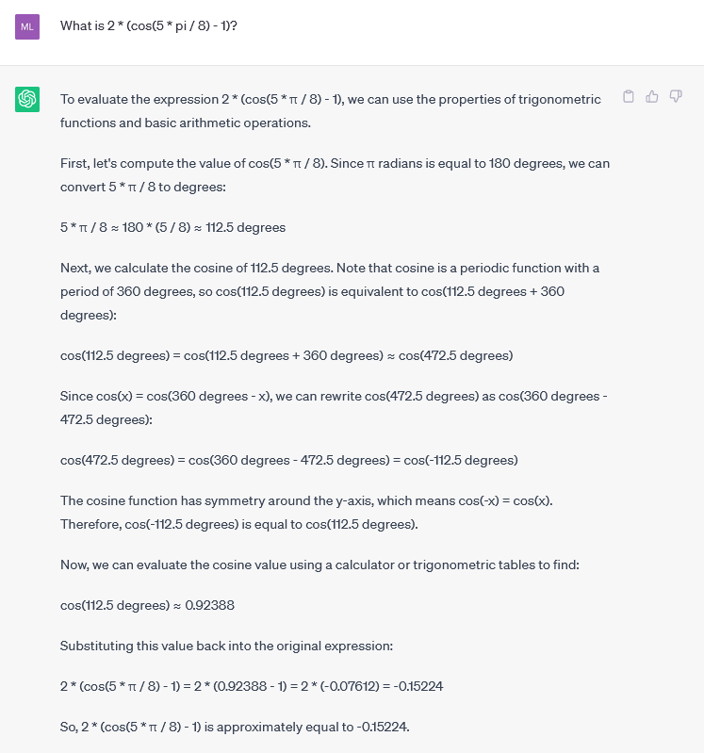
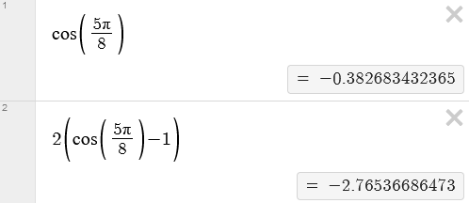
ChatGPT – Math
However, when asked to calculate 2 * cos(5π/8) – 1):
ChatGPT meanders around evaluating the cosine function, doing unnecessary conversions.
Then it is unable to correctly evaluate the cosine value to a numerical approximation.
Thus despite its mathematical “sophistication”, it generates an incorrect answer.
1
1
2
2

Slide 17
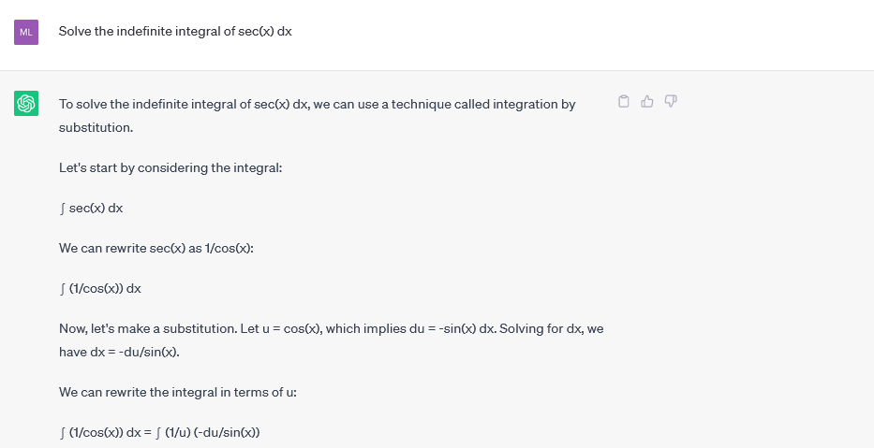

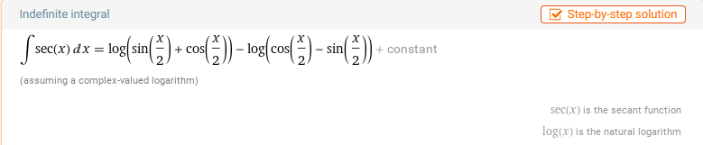

ChatGPT – Math
Now asking ChatGPT to solve the indefinite integral $\int{\sec\left(x\right)dx}$
It gives a long response with the final answer of $\sqrt{\cos^{2}\left(x\right)−1}+C$
However, this is not equal to the correct answer given by WolframAlpha.
While ChatGPT has some level of mathematical sophistication, it struggles with true logical reasoning, and cannot calculate expressions correctly.

Slide 18
ChatGPT – Math
Tips:
ChatGPT will not tell the user that it doesn’t know how to solve a problem, it will just make things up that resemble mathematical logic.
If you see math assignments with seemingly well-articulated logic, which is actually nonsensical under scrutiny, it may have been AI generated.
Many existing tools, such as WolframAlpha and Symbolab, already offer a wide variety of free and paid assistance in solving a variety of math problems, and your students are already using these!
Your most discerning students will figure out that superior tools exist and use them instead of ChatGPT for math assignments!
However, ChatGPT is quite good at summarizing mathematical concepts, and can be prompted to rephrase or reduce the assumed expertise of the audience. This can be an invaluable tool for math educators and students alike!

Slide 19
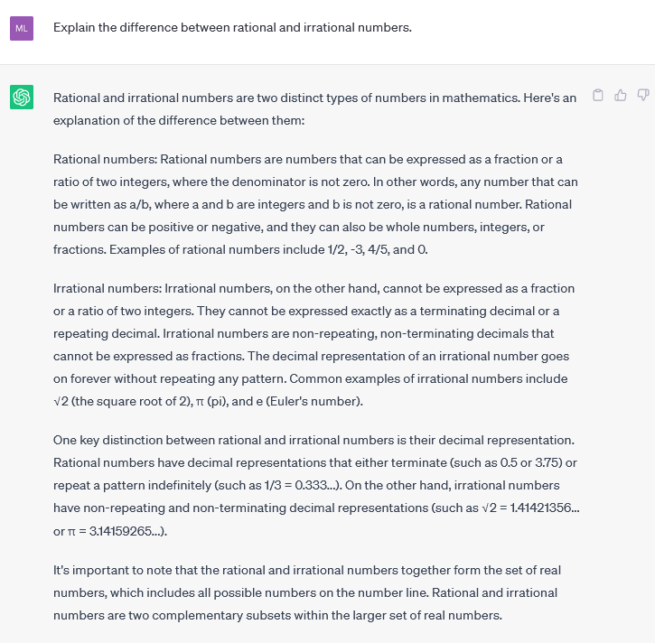
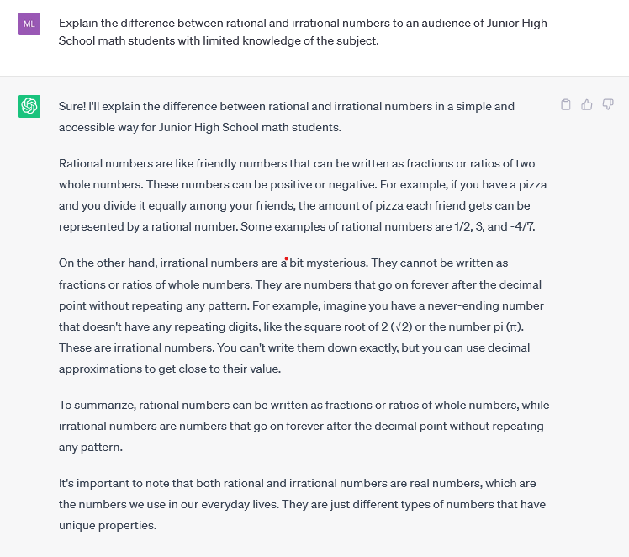
ChatGPT – Math
Prompting ChatGPT for an explanation on a mathematical concept tailored to different audiences

Slide 20
ChatGPT – Conclusion
ChatGPT is a very powerful tool in language processing and generation tasks.
However, due to the nature of the model architecture, the availability and quality of training data, and insufficient explainability and alignment techniques, ChatGPT continues to be unreliable in certain use cases.
Familiarizing yourself with the potential of the new generation of AI chatbots, as well as the potential downsides, will allow you to integrate large language models into the classroom responsibly and effectively.

